Slide 1
Distributed Database Systems
Welcome!

Slide 2
Teaching Staff
Instructor: Ju Fan (范举)
Associate Professor
School of Information / DEKE Lab
Renmin University of China Email: fanj@ruc.edu.cn
Homepage: http://iir.ruc.edu.cn/~fanj/
Office: Room 500, Information Building

Slide 3
Course Name
Distributed
Database
Systems

Slide 4
Teaching language
English

Slide 5
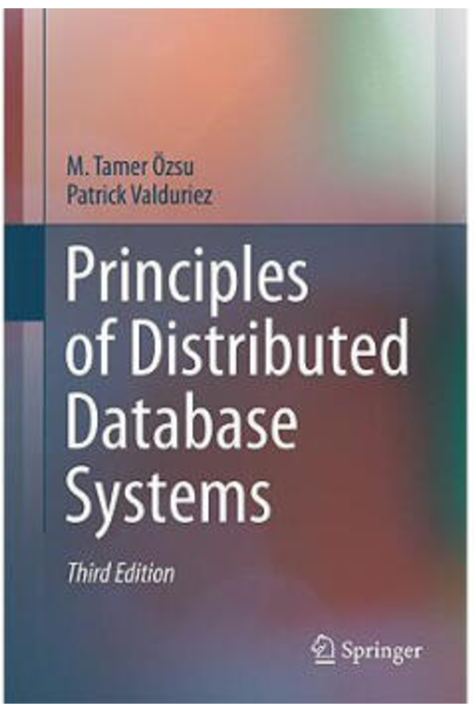

Textbook
Principles of Distributed Database Systems
(3nd Edition)
M. Tame Özsu
Patrick Valduriez
Springer, 2011
Price: RMB 73.30

Slide 6
Reference
Distributed Databases: Principles and Systems Ceri & Pelagatti McGraw-Hill, 1985
许多中文参考书

Slide 7
Prerequisite
Undergraduate database course
Computer networks

Slide 8
Contents- theory
Chapter # | Title
1 | Introduction
3 | Distributed Database Design
6 | Overview of Query Processing
7 | Query Decomposition and Data Localization
8 | Optimization of Distributed Queries
10 | Introduction to Transaction Management
11 | Distributed Concurrency Control
12 | Distributed DBMS Reliability

Slide 9
Contents- system
Design and implementation of a course project of DDBMS capable of
defining DDB
support of SQL
Teamwork of 2-3 members
To be evaluated by a benchmark of data and queries
Demo

Slide 10
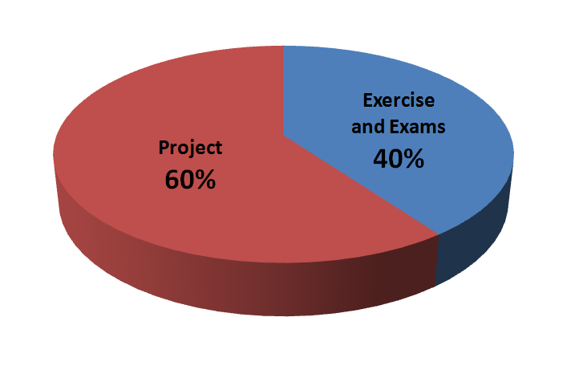
Evaluation

Slide 11
Course home page
https://github.com/fanju1984/ddb/wiki
On the home page you can
Get notifications
Download the latest courseware
Download other related materials

Slide 12
Why take this course?

Slide 13
History of DB Systems
1960’s
IBM IMS
DBTG network data model
1970’s
E. F. Codd RDB model
Pioneering systems: INGRES, System R
1980’s
Booming of RDBs
Federated, Multi-database
DDB
OODB

Slide 14
History of DB Systems
1990’s
Merge of RDB and OODB
Internet Fame
P2P model
2000’s
XML DB
Web data processing
Semantic Web
Data Integration

Slide 15
History of DB Systems
2010’s
NoSQL
NewSQL
More details in course 分布式系统与云计算（卢卫副教授）

Slide 16
Why study DDB
Reason 1: The fundamental principles for parallel & distributed data processing
Reason 2: Scientific training on

Slide 17
不要问一个PhD哪些问题？
你今天干嘛了？
你做这个有啥意义？
开始写论文了吗？
论文还没发表吗？
你到底什么时候毕业？
这究竟是你第几年了？

Slide 18
Why study DDB
Reason 1: The fundamental principles for parallel & distributed data processing
Reason 2: Scientific training on
basic concepts
problem formulation
identification of key technical issues
algorithm presentation
system level design and implementation

Slide 19
Reading for learning
Problem formulation
What is the problem
Relevant Concept definition
Mathematical representation
Algorithm description & formal presentation
What is the method
Writing pseudo code
Proof of your works
Theoretical analysis
Experimental study

Slide 20
Reason 3: Teaching language
English

Slide 21
Friendly Reminding Messages from the Instructor

Slide 22
课程设计中应注意的问题
选课太多，疲于奔命，无暇顾忌
缺乏总体设计，系统划分不当，随意编程，接口混乱
设计目标很高，实现时想一步到位，指望一次成功
选择开发环境欠考虑
代码管理混乱，难以形成正确版本

Slide 23
实现时不考虑调试需求（例如反复建立表格，生成数据字典）
匆忙上马，反复折腾
各自为战，缺少交流
三人平等，没有核心
分工不均，事后抱怨

Slide 24
Good Luck!

